Slide 1


Social Robots for Education: A review
Elective in Artificial Intelligence
Human-Robot Interaction
Prof. Luca Iocchi
Olga Sorokoletova - 1937430

Slide 2
Current Reference
T. Belpaeme, J. Kennedy, A. Ramachandran, B. Scassellati, F. Tanaka
"Social Robots for Education: A review", August 2018, Article in Science Robotics

Slide 3

Presentation Outline
Key Questions
Efficacy
Common Measures
Experiments Designs
Efficacy of Robots in Education
Embodiment
Social Robots VS Virtual Pedagogical Agents
Robot Appearance
Robot Behaviour
Interaction role
Key Challenges
Technical challenges
Full Set of Challenges
Personal Commentaries

Slide 4
Key Questions

Slide 5
Three Key Questions
Efficacy. What are the cognitive and affective outcomes when robots are used in education?
Embodiment. What is the impact of using a physically embodied robot when compared with alternative technologies?
Interaction role. What are the different roles the robot can take in an educational context?

Slide 6

Efficacy: Common Measures for Determining Learning Outcomes
Cognitive
require a controlled knowledge assessment
Learning gain, measured as difference between pre- and posttest score;
Administer posttest either immediately after exposure to robot or with delay;
Correct for varying initial knowledge, e.g. using normalized learning gain;
Difference in completion time of test;
Number of attempts needed for correct response.
Affective
can be measured by using questionnaires and observational studies
Persistence, measured as number of attempts made or time spent with robot;
Number of interactions with the system, such as utterances or responses;
Coding emotional expressions of the learner, can be automated using face analysis software;
Godspeed questionnaire, measuring the user’s perception of robots;
Tripod survey, measuring the learner’s perspective on teaching, environment and engagement;
Immediacy, measuring psychological availability of the robot teacher;
Evolution of time between answers, e.g. to indicate fatigue;
Coding of video recordings of participants responses;
Coding or automated recording of eye gaze behavior (to code attention, for example);
Subjective rating of the robot’s teaching and the learning experience;
…

Slide 7
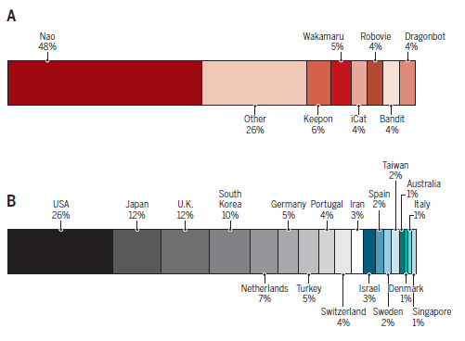
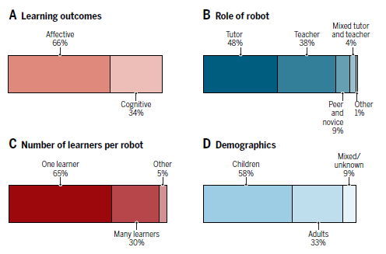






Types of robots used in the studies
Type of learning outcome studied
Role of the robot in the interaction
Division between children and adults
Number of learners per robot
Nations where the research studies were run

Slide 8
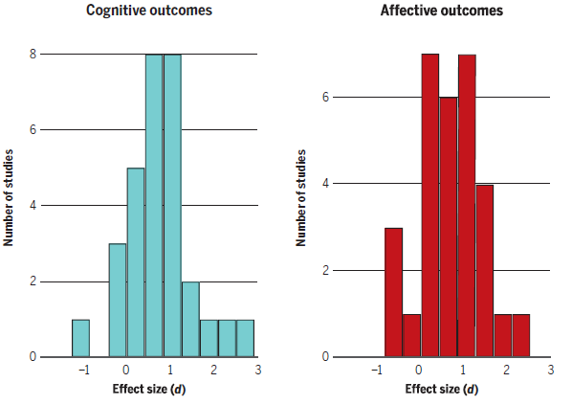
Efficacy: Efficacy of Robots in Education
A quantitative measure of the magnitude of the experimental effect: the larger - the stronger the relationship between two variables
Histograms of effect sizes (Cohen’s d) for all cognitive and affective outcomes of robot tutors in the meta-analysis
The difference between two means in standard deviation units
A statistical analysis that combines the results of multiple scientific studies

Slide 9


Embodiment: Social Robots VS Virtual Pedagogical Agents
Why do we want to use social robots for education?
Challenges
Benefits
Expense of additional hardware;
Need for maintenance;
Challenges of distribution and installation.
Can be used for curricula (e.g. tutoring physical skills: basketball, handwriting, rehabilitation, etc) or populations (individuals with visual impairments, children under the age of two) that require engagement with the physical world;
Users show more social behaviour (e.g. yield more compliance with tutor’s requests) that is beneficial for learning;
Users show increased learning gains (task performance).
Use of a robot in an educational setting must be explicitly justified

Slide 10
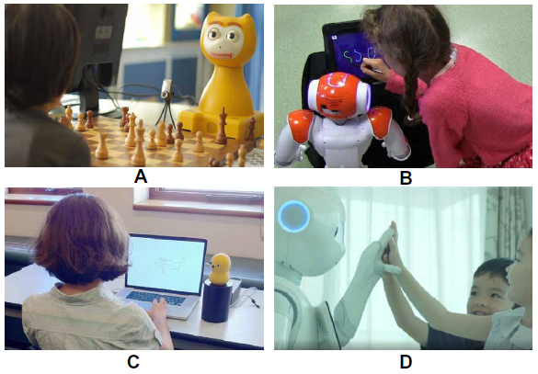
Embodiment: Robot Appearance
What exactly it is about the robot’s appearance that promotes learning?
iCat robot teaching
young children to play chess
Nao robot supporting a child to improve handwriting
Keepon robot tutoring an adult in a puzzle game
Pepper providing motivation during English classes

Slide 11

Embodiment: Robot Behaviour
Almost any strategy or social behaviour of the robot aimed at increasing learning outcomes has a positive effect
Personalization is important: adaptive delivery of learning material (as in ITS), but also socially supportive behavior
When to limit social behavior to allow students to concentrate on problem solving?
What if positive learning outcomes are not directly caused by the robot having a physical presence, but rather the physical presence of the robot promotes social behaviour in the learner?
Effectiveness
Personalization
Using a child’s name;
Referring to previous interactions;
Displaying congruent gaze behavior;
Showing empathy with the learner;
…
Time Frames
The Other Way Round

Slide 12
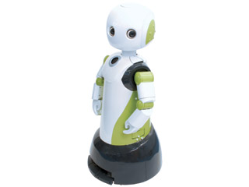
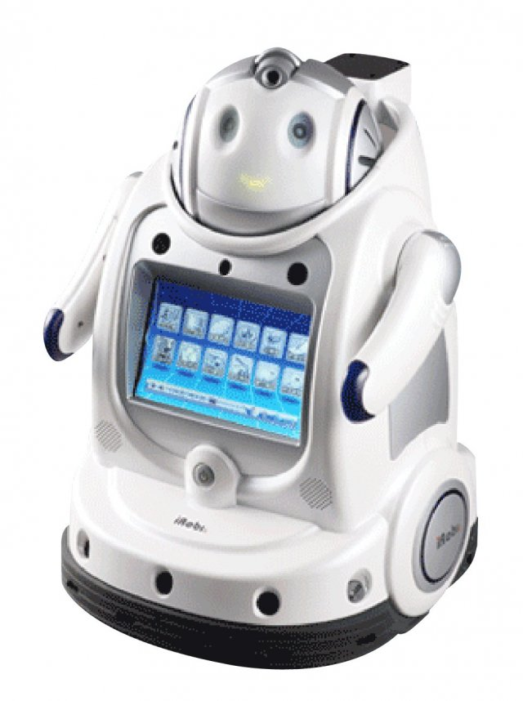
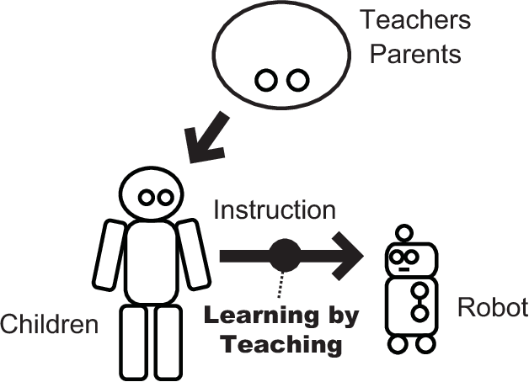
Interaction Role: Robot Role
Robot as tutor
Robot as novice
Robot as peer
provides direct curriculum support through hints, tutorials and supervision
enhances both concentration on learning activities and academic performance
mostly focuses on one-to-one interactions
involves the learner making an effort to teach the robot, which has a direct impact on their own learning outcomes
requiring a higher level of understanding of the material and of the internal representations of their robot partner
robot is presented as a more knowledgeable peer, guiding the student along a learning trajectory
longer periods of attention, faster and more accurate responses
Robovie
IROBI

Slide 13
Key Challenges

Slide 14

Technical Challenges of Building Social Robot Tutors
Which problems do we face when we want to use social robots for education?
Fluent and contingent interaction between social robots and learners requires the seamless integration of a range of processes in artificial intelligence and robotics
Perception
Action
Personalization
speech recognition, visual social signal processing
conflicting educational theories even in human-based instruction,
choosing an appropriate emotional support strategy,
appropriate gestures and gazes, attention-guiding behaviour,
…
nonverbal behaviour,
verbal behaviour,
adaptive content progression
but
alternative input media (such as touch screens)
but
constraints the natural flow of interaction

Slide 15
Full Set of Challenges
Robots for learning require a tightly integrated endeavour which involves solving technical challenges and changing educational practice;
Introducing social robots in the school curriculum poses a logistical challenge;
The generation of content for social robots for learning is nontrivial;
Currently, the value of the robot lies in tutoring some specific skills, and it is a good question how wide range of roles robots can take up in general;
For the time being, robots are mainly deployed in elementary school settings, and it is unclear whether the approaches that work well for younger children transfer to tutoring older learners;
There might be other problems specific to social robots that still need to be identified and for which solutions will be needed since the field is not fully-explored;
Ethical issues: how far do we want the education to be delegated to machines, and social robots in particular? Might robots lead to an impoverished learning experience?

Slide 16
Personal Commentaries

Slide 17


Personal Commentaries
About the Reference Paper. The value of this article consists in its wide coverage of topics and an attempt to aggregate all existence knowledge about social robotics in education domain which is especially useful to create the general impression for the newcomers in the field (and to have a starting point for the project)
About Social Robotics for Education. Despite all the technical, logistical and other challenges and limitations, inside the limited settings where social robots are currently applied, they show the results, comparable with the ones of a human tutor and overperforming alternative learning technologies. Therefore, further exploration of the area is promising.

Slide 18

Thank you for the attention!

